Slide 1
ALCOHOLICS ANONYMOUS
ALCOHOLICS ANONYMOUS IS A FELLOWSHIP OF MEN AND WOMEN WHO SHARE THEIR EXPERIENCE, STRENGTH AND HOPE WITH EACH OTHER THAT THEY MAY SOLVE THEIR COMMON PROBLEM AND HELP OTHERS TO RECOVER FROM ALCOHOLISM.
THE ONLY REQUIREMENT FOR MEMBERSHIP IS A DESIRE TO STOP DRINKING. THERE ARE NO DUES OR FEES FOR MEMBERSHIP; WE ARE SELF-SUPPORTING THROUGH OUR OWN CONTRIBUTIONS.
AA IS NOT ALLIED WITH ANY SECT, DENOMINATION, POLITICS, ORGANISATION OR INSTITUTION; DOES NOT WISH TO ENGAGE IN ANY CONTROVERSY; NEITHER ENDORSES NOR OPPOSES ANY CAUSES.
OUR PRIMARY PURPOSE IS TO STAY SOBER AND HELP OTHER ALCOHOLICS ACHIEVE SOBRIETY.

Slide 2
THE 12 STEPS AND WHAT THEY MEAN TO US.
Alcoholics
Anonymous

Slide 3
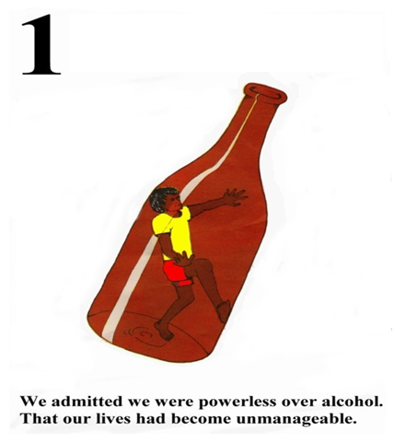
THE FIRST STEP is to admit to OURSELVES that we are Powerless over alcohol……If when we honestly want to, we cannot give up the grog, we always start again, thinking .”This time will be different”. When we start - we cannot stop at one, we keep on drinking AND IT ALWAYS CAUSES TROUBLE. We cannot manage our lives.

Slide 4
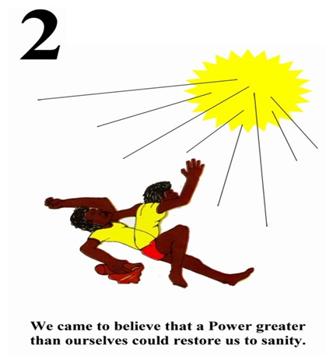
Step 2
We are crazy to pick up the grog again when we know we will get into more trouble , we do mad things with a drink in us.
We need help from a power greater than ourselves which we can call the Creator, Wundjina, Spirit of Nature, Our Ancestors, Friend, Elder, or if we want to...God
It has to be a power greater than ourselves because we have not been able to get off the grog on our own.

Slide 5
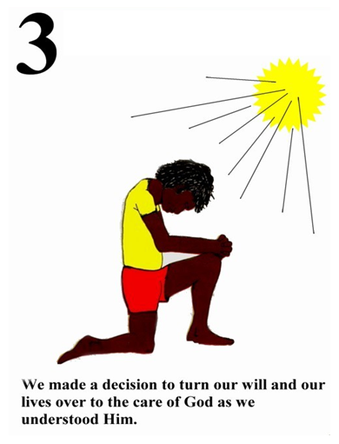
Step 3
This Step asks us to make a decision to turn our will and our lives over to our own idea of what God is, no –one else’s idea of a God.
Remember.........
It is a God of our own understanding.

Slide 6
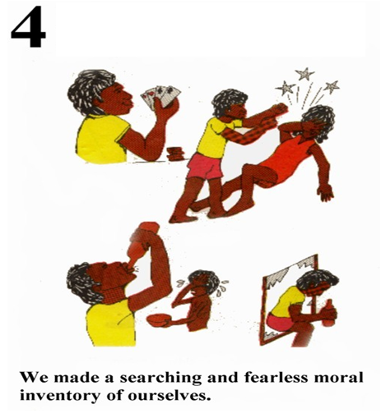
Step 4
This Step is saying to us that we need to look at the things we used to do as a drinker and be honest about it.
We look at who we resent/hate, what we fear and how our behaviors affected others.

Slide 7
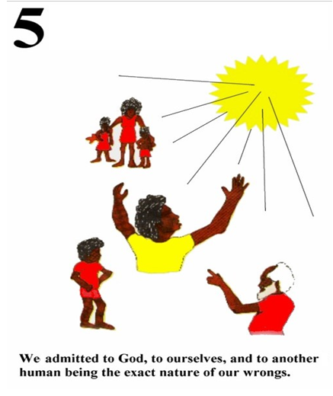
Step 5
We talked to the God of our own understanding and admitted it all, then we admitted it to ourselves , next we talked with someone else who has done the Steps and recovered from alcoholism- usually our sponsor.

Slide 8
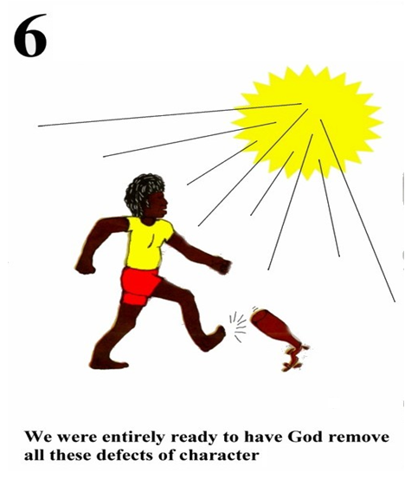
Step 6
In Step 5 we realised that we had some defects/faults in our character.
Now we become ready to have the God of our own understanding remove them so we will not need to drink again.

Slide 9
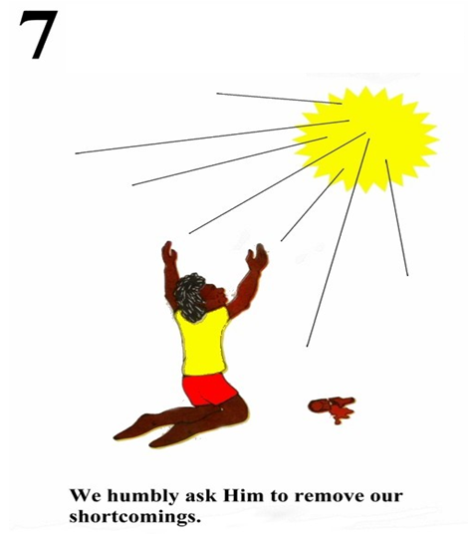
Step 7
In this Step we are humble enough to ask for help to get rid of any rubbish we may still be thinking.

Slide 10
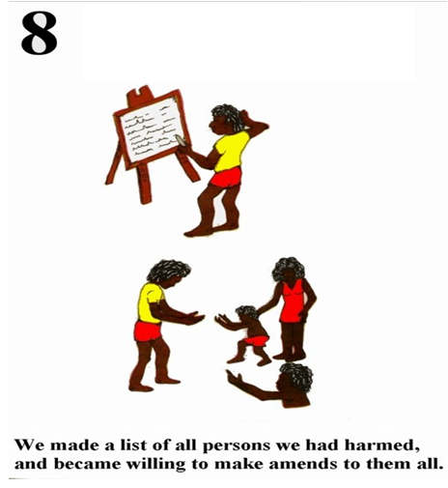
Step 8
From our inventory list we get the names of people we had harmed and we want to say sorry to them for what we did when we were on the grog.

Slide 11
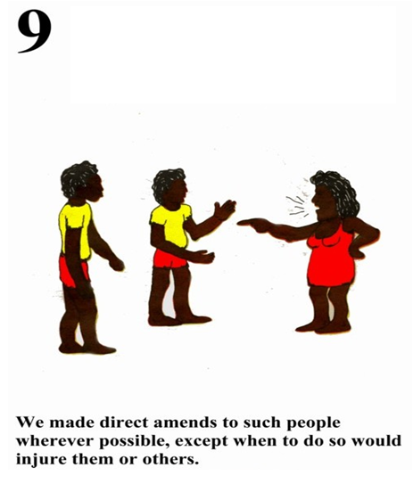
Step 9
We go to these people and tell them we are sober now, we say we are sorry for hurting them. We have to be careful not to hurt their feelings anymore, our sponsor will help us with how to do it.

Slide 12
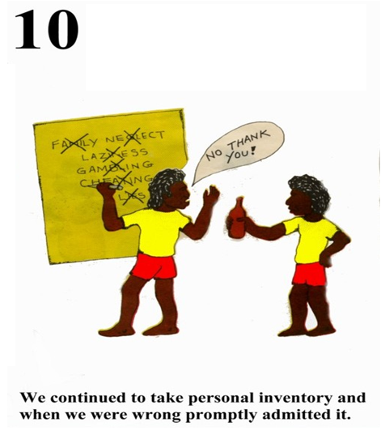
Step 10
Now we are recovered and doing this program on a daily basis we have to keep making sure we are still looking at our defects and when we make mistakes we have fix it straight away.

Slide 13
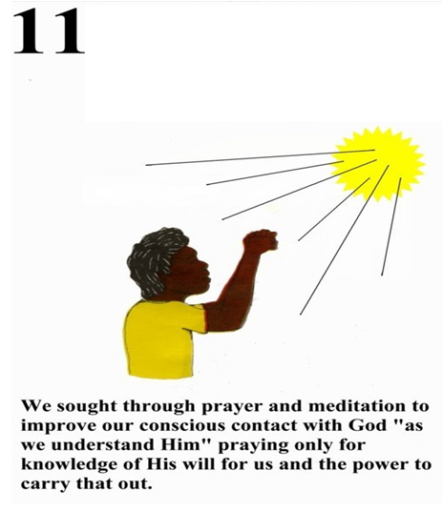
Step 11
We keep in contact with the God of our own understanding by asking to improve our thinking and understanding so we can help where we can.
This can be a prayer to the God of your understanding.

Slide 14
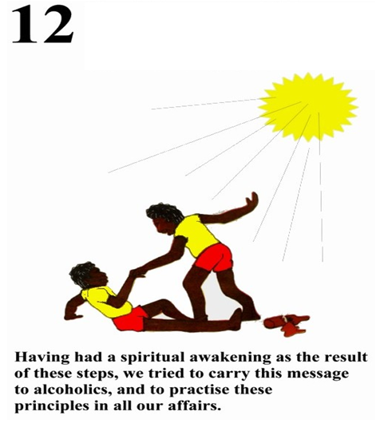
Step 12
Now that our Spirits have been awakened by doing the other 11 Steps and we have recovered, we can now turn around and offer to help other people the same way we got help.
We carry the message of the 12 Steps to other alcoholics who are suffering as we were when we started at Step One.

